Slide 1
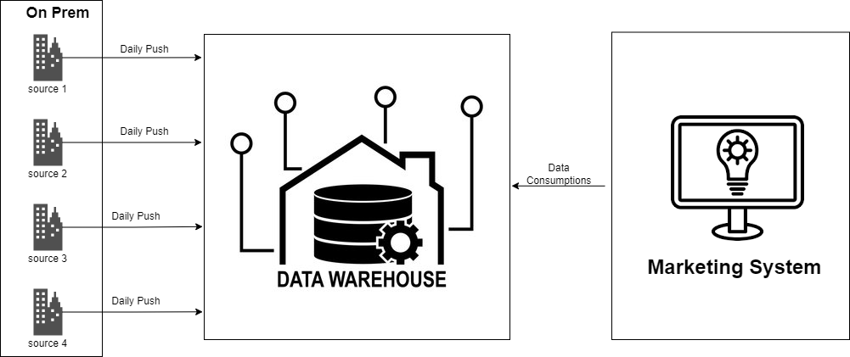
Assignment 1 Definition
Case Study :
The XYZ bank has opted to transition away from utilizing Datawarehouse and is embarking on a journey towards employing centralized cloud-based Azure storage. As part of this shift, mechanisms have been established within On-Prem systems and other sources to transmit incremental daily snapshots of data to Azure Datalake Storage.
Traditionally, the Marketing System (MS) accessed the necessary datasets on a daily basis from the Datawarehouse for the purpose of generating dashboards. However, in light of the bank's strategic pivot, the MS team is now tasked with designing a system to daily ingest the datasets from the centralized storage into their designated storage account. They will also need to execute requisite operations on the datasets to ensure they are readily accessible for dashboarding purposes.
In our capacity as Senior Azure Engineers, it is imperative that we collaborate to devise a scalable solution for the MS team's requirements.

Slide 2
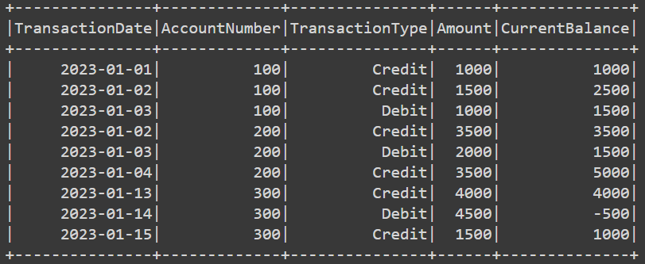
Assignment 2 Definition
Expected Output
Case Study :
The task is to calculate the balance of each account number after each transaction using the provided dataset.
The dataset contains the details of all the credits and debits made to accounts daily.
The objective is to read the given dataset and perform transformation using PySpark code to fulfill this requirement.
Sample Dataset :

